Slide 1

Customer Churn
Understanding Key Churn Drivers and the Financial Toll on the Bank
Prepared by Justice Paintsil, Data Analyst

Slide 2

Our Story at a Glance
1
Churn Rate Overview
2
What Drives Churn?
3
Financial Impact of Churn
4
Turning the Tide: Our Strategic Pivot

Slide 3


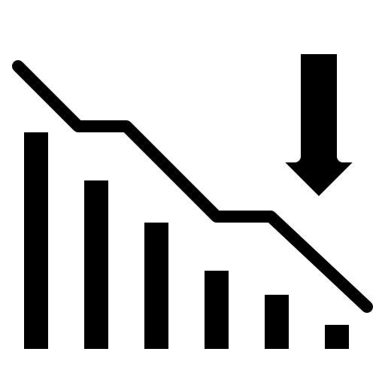
One in Five Customers Are Exiting the Bank
10,000 Total Customers Analyzed
Significant sample size to analyze and pinpoint
churn drivers across diverse segments.
2,037
Customers Lost
Signals a pressing need for strategic intervention.
7,963
Customers Retained
Highlights a critical opportunity for improvement.
$185,588,095
Total Balance Lost
Churned customers took 24.3% of the total balance.
$579,270,798
Total Balance Retained
59.2% current balance poses a risk if churn is not curbed.

Slide 4
What Drives Churn?
Key Drivers
Demographic
Age
Gender
Geography
Account Relationship
Activity Status
Number of Products
Weak Standalone Drivers
Financial Profile
Balance
Credit Score
Non-Drivers
Account Relationship
Credit Card Ownership
Tenure
Financial Profile
Estimated Salary

Slide 5
Peak Wealth Age Group at Critical Risk
49.5% Churn Rate (Ages 45-60)
Nearly half of our 'Golden Demographic' leaves
before retirement.
Peak Wealth Years
(45-60)
Generational Loyalty Gap
While Millennials remain stable, we are failing
clients during their highest net-worth years.
Strategic Vulnerability
Competitors are likely targeting our mature clients
with better wealth-preservation offers.

Slide 6
Gender Disparity and Inactivity Accelerate Churn
Female Customers Show Higher Churn Compared to Males
Churn Rate by gender
Female
Male
The Engagement Gap for Female Clients
Analysis signal a critical "service gap" where current retention offerings may not align with the specific financial priorities or engagement styles of this demographic.
Dormant Value Before Exit
Customer inactivity is an "early warning" signal. Dormancy is a direct precursor to total balance exit, representing a compounding loss of future lifetime value.

Slide 7
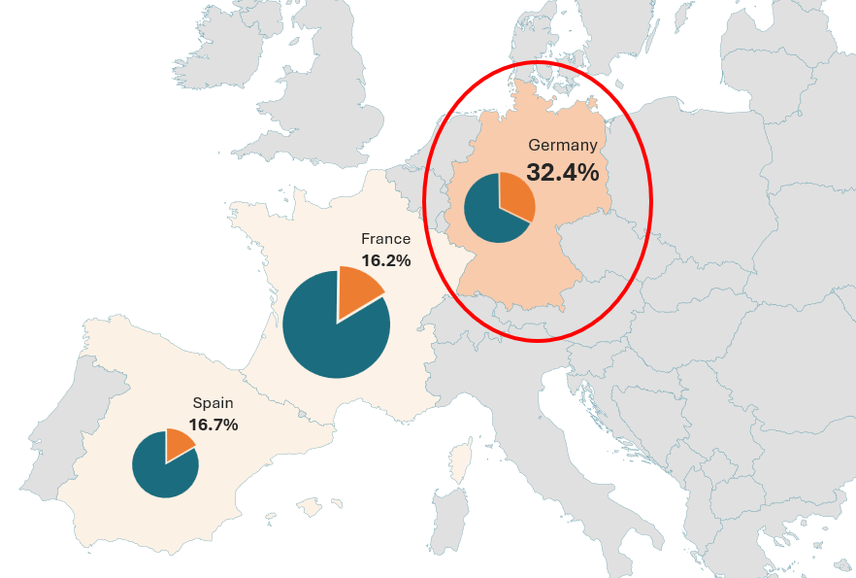
Germany: A Concentration of Risk
High-Risk Attrition in Germany Despite Smaller Customer Base
Churn Rate and Customer Volume Across European Markets
Churn Rate Matrices
Country vs Gender
Retained Customers
Churned Customers
France
Country
Germany
Spain
Female Male
Gender
Country vs Activity Status
France
Country
Germany
Spain
Inactive Active
Activity Status
German Market Disruption
Churn Rate is double that of France or Spain.
Over $98M capital loss (1/3 of total deposits) in the analyzed period.
Indicates local competitive pressure or regional service quality dissatisfaction.

Slide 8
The 1-Product Vulnerability: A High-Volume Exodus
1-Product Segment
Most significant loss in nominal value,
representing the bulk of our customer flight (1,409).
Our largest exposed risk category with 5,084 total
customers.
3 & 4-Product Segment
While churn rates are alarmingly high, these groups
represent only 3.26% (326) of our customer base,
making them less significant to the bottom line.

Slide 9
We are Losing our Wealthiest Clients
25% Higher Balance in Churners
Departing clients have a higher average balance
than those staying.
Adverse Selection Pattern
The bank is losing its most liquid assets
while retaining lower-balance accounts.
Asset Management Impact
This outflow directly impairs our ability to fund
competitive lending and mortgage products.

Slide 10
Churn is Draining the Bank’s Financial Lifeline
High Cost of Replacing “Cheap” Capital
Losing core deposits forces the bank to replace "cheap" internal funding with expensive market borrowing, directly shrinking profit margins and destabilizing liquidity.
Eroding Our High-Margin Revenue Base
High-earning churn creates a "multiplier loss," as these anchor clients represent the highest potential for lucrative cross-sales like mortgages, investments, and premium credit.

Slide 11


Wealth Management for Seniors
Redesign our value proposition for the 45–60 demographic. This should include loyalty interest rates, dedicated financial advisors, and specialized retirement planning to counter the near 50% churn rate in this group.
German Market Audit
Conduct a deep-dive competitive analysis and service audit in Germany to identify if the high churn is due to localized competitor offers or poor regional service quality.
Turning the Tide: Our Strategic Pivot
Optimization of Product Mix
Pivot marketing efforts and incentives to move 1-Product customers to a 2-Product "Anchor" status. Investigate the 3+ product segment to remove service friction or fee structures that are driving those customers away.
Affluent Customer Re-engagement
Use predictive triggers to flag inactive customers with balance of $100K+ for swift personal outreach and "active-status" incentives (e.g., fee waivers for 6 months, premium loan rates, and bonuses for referrals).
Gender-Inclusive Service
Tailor communication and product benefits to address the specific needs of female professionals and heads of households to recoup significant lost revenue.

Slide 12
The Time to Turn the Tide is Now
We welcome your questions and discussions

